Slide 1
CSCE 689: Special Topics in Modern Algorithms for Data Science
Lecture 26
Samson Zhou

Slide 2
Presentation Schedule
November 27: Chunkai, Jung, Galaxy AI
November 29: STMI, Anmol, Jason
December 1: Bokun, Ayesha, Dawei, Lipai

Slide 3
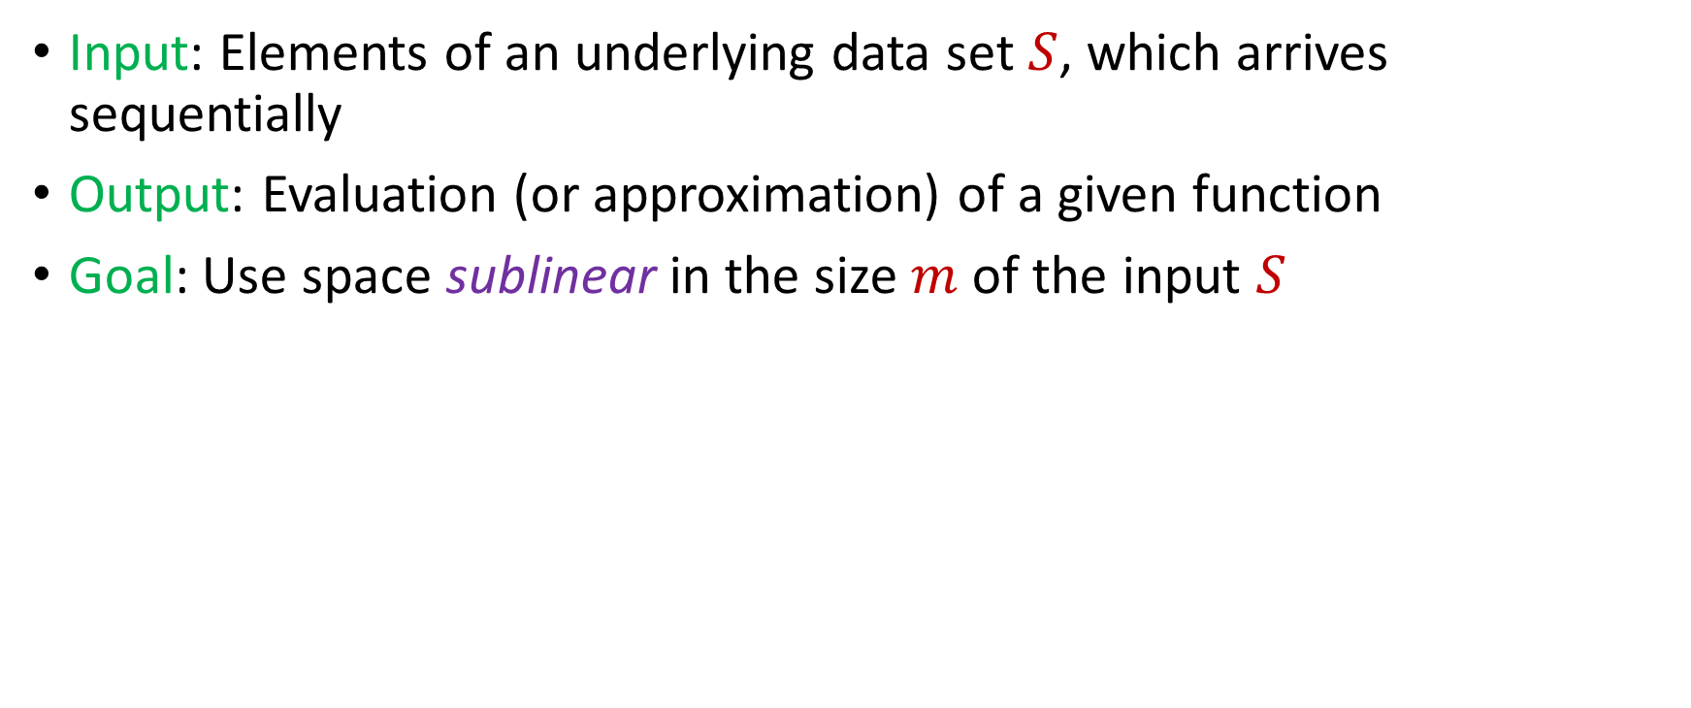
Streaming Model
Input: Elements of an underlying data set $S$, which arrives sequentially
Output: Evaluation (or approximation) of a given function
Goal: Use space sublinear in the size $m$of the input $S$
Notes:
Let’s start by breaking down each of the terms in the title. To understand the sliding window model, we first have to understand the streaming model of computation, in which elements of an underlying data set S, arrive sequentially and the goal is to evaluate or approximate some given function on this dataset, using space sublinear in S. In the sliding window model, only the W most recent updates form the underlying data set

Slide 4
47 72 81 10 14 33 51 29 54 9 36 46 10

Slide 5
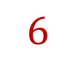
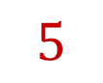
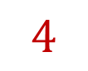
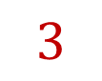
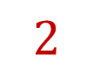
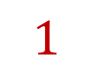
$$1$$
$$2$$
$$5$$
$$6$$
$$4$$
$$3$$

Slide 7
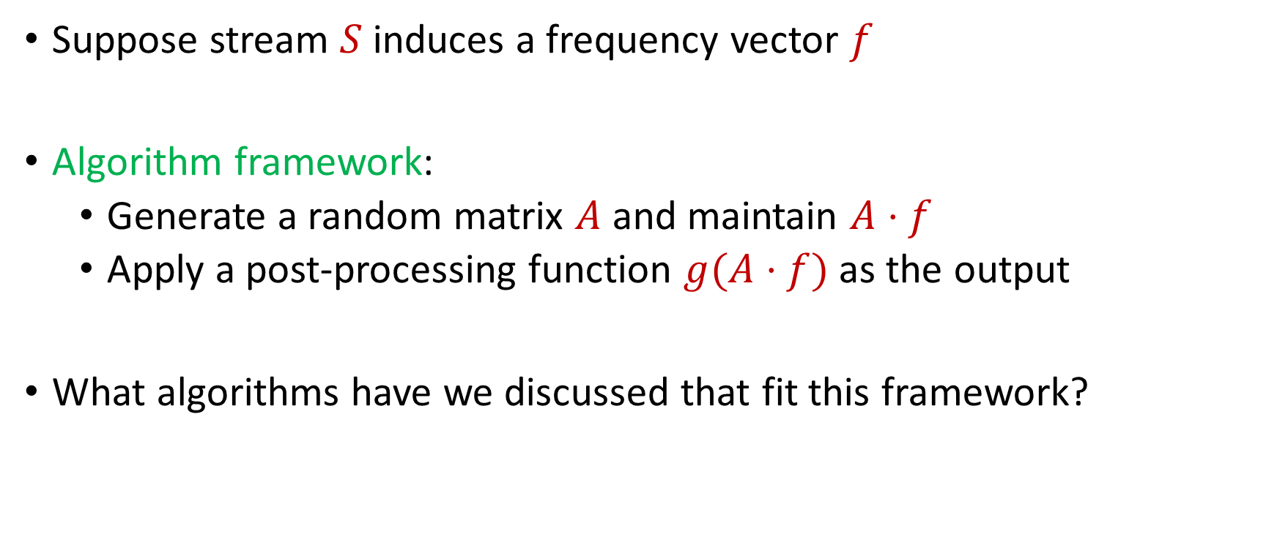
Linear Sketch
Suppose stream $S$induces a frequency vector $f$
Algorithm framework:
Generate a random matrix $A$ and maintain $A⋅f$
Apply a post-processing function $g(A⋅f)$ as the output
What algorithms have we discussed that fit this framework?
Notes:
Let’s start by breaking down each of the terms in the title. To understand the sliding window model, we first have to understand the streaming model of computation, in which elements of an underlying data set S, arrive sequentially and the goal is to evaluate or approximate some given function on this dataset, using space sublinear in S. In the sliding window model, only the W most recent updates form the underlying data set

Slide 8
Linear Sketch
What algorithms have we discussed that fit this framework?
YES: AMS, CountSketch, CountMin, sparse recovery, distinct elements, coreset construction for clustering
NO: Greedy algorithm for maximal matching, connectivity, bipartiteness, MisraGries
Notes:
Let’s start by breaking down each of the terms in the title. To understand the sliding window model, we first have to understand the streaming model of computation, in which elements of an underlying data set S, arrive sequentially and the goal is to evaluate or approximate some given function on this dataset, using space sublinear in S. In the sliding window model, only the W most recent updates form the underlying data set

Slide 9
Linear Sketch
What algorithms have we discussed that fit this framework?
YES: AMS, CountSketch, CountMin, sparse recovery, distinct elements, coreset construction for clustering
NO: Greedy algorithm for maximal matching, connectivity, bipartiteness, MisraGries
Which of these algorithms work for insertion-deletion streams?
Notes:
Let’s start by breaking down each of the terms in the title. To understand the sliding window model, we first have to understand the streaming model of computation, in which elements of an underlying data set S, arrive sequentially and the goal is to evaluate or approximate some given function on this dataset, using space sublinear in S. In the sliding window model, only the W most recent updates form the underlying data set

Slide 10
Linear Sketch
What algorithms have we discussed that fit this framework?
YES: AMS, CountSketch, CountMin, sparse recovery, distinct elements, coreset construction for clustering
NO: Greedy algorithm for maximal matching, connectivity, bipartiteness, MisraGries
Which of these algorithms work for insertion-deletion streams?
YES: AMS, CountSketch, CountMin, sparse recovery, distinct elements, coreset construction for clustering
NO: Greedy algorithm for maximal matching, connectivity, bipartiteness, MisraGries
Notes:
Let’s start by breaking down each of the terms in the title. To understand the sliding window model, we first have to understand the streaming model of computation, in which elements of an underlying data set S, arrive sequentially and the goal is to evaluate or approximate some given function on this dataset, using space sublinear in S. In the sliding window model, only the W most recent updates form the underlying data set

Slide 11
Linear Sketch
Theorem [LiNguyenWoodruff14]: For sufficiently long data streams with arbitrarily large coordinates at intermediate stages of the stream, any one-pass insertion-deletion streaming algorithm can be implemented with a linear sketch
Notes:
Let’s start by breaking down each of the terms in the title. To understand the sliding window model, we first have to understand the streaming model of computation, in which elements of an underlying data set S, arrive sequentially and the goal is to evaluate or approximate some given function on this dataset, using space sublinear in S. In the sliding window model, only the W most recent updates form the underlying data set

Slide 12
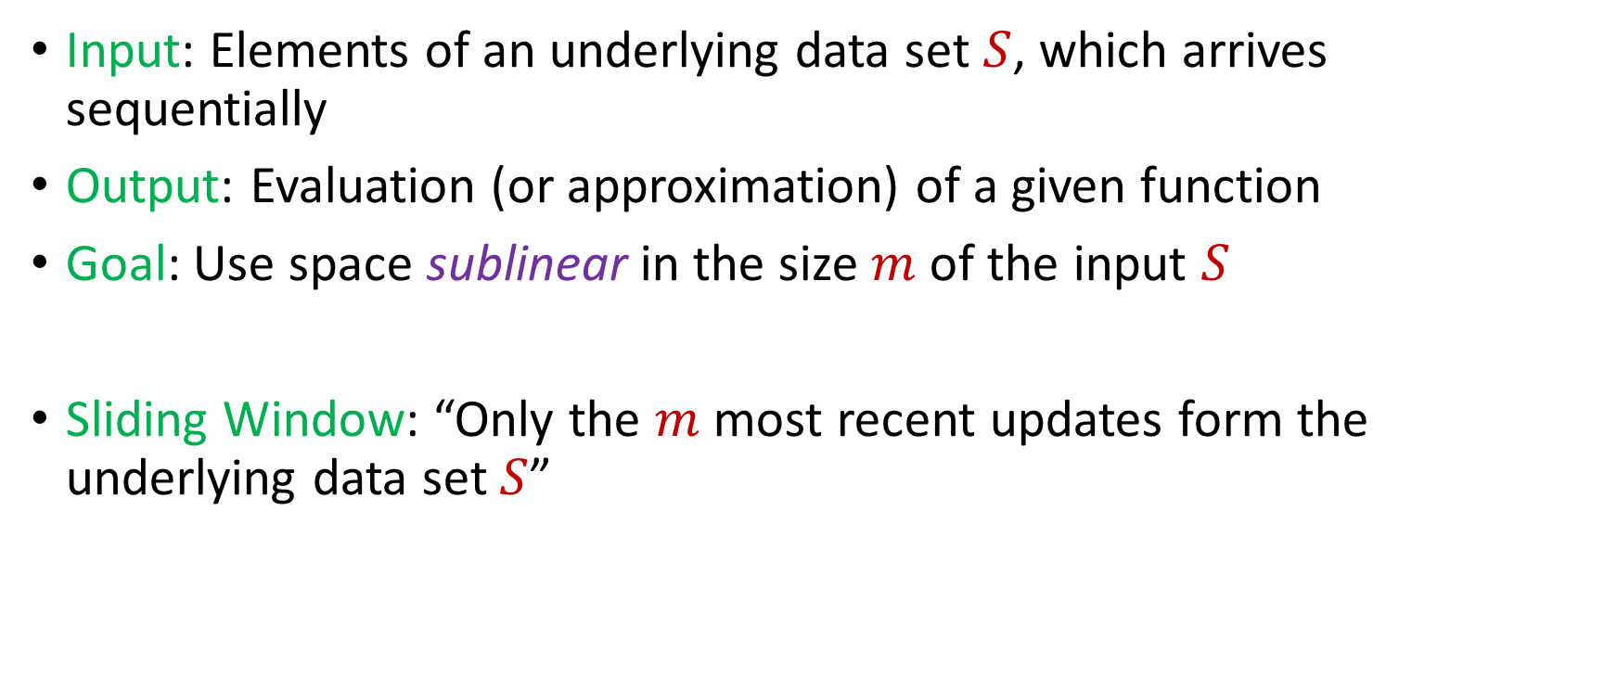
Sliding Window Model
Input: Elements of an underlying data set $S$, which arrives sequentially
Output: Evaluation (or approximation) of a given function
Goal: Use space sublinear in the size $m$of the input $S$
Sliding Window: “Only the $m$ most recent updates form the underlying data set $S$”
1 0 1 1 1 0 0 1
Notes:
Let’s start by breaking down each of the terms in the title. To understand the sliding window model, we first have to understand the streaming model of computation, in which elements of an underlying data set S, arrive sequentially and the goal is to evaluate or approximate some given function on this dataset, using space sublinear in S. In the sliding window model, only the W most recent updates form the underlying data set

Slide 13
Sliding Window Model
Input: Elements of an underlying data set $S$, which arrives sequentially
Output: Evaluation (or approximation) of a given function
Goal: Use space sublinear in the size $m$of the input $S$
Sliding Window: “Only the $m$ most recent updates form the underlying data set $S$”
1 0 1 1 1 0 0 1 1

Slide 14
Sliding Window Model
Input: Elements of an underlying data set $S$, which arrives sequentially
Output: Evaluation (or approximation) of a given function
Goal: Use space sublinear in the size $m$of the input $S$
Sliding Window: “Only the $m$ most recent updates form the underlying data set $S$”
1 0 1 1 1 0 0 1 1 0

Slide 15

Sliding Window Model
Input: Elements of an underlying data set $S$, which arrives sequentially
Output: Evaluation (or approximation) of a given function
Goal: Use space sublinear in the size $m$of the input $S$
Sliding Window: “Only the $m$ most recent updates form the underlying data set $S$”
Emphasizes recent interactions, appropriate for time sensitive settings
1 0 1 1 1 0 0 1 1 0 1
Notes:
The sliding window model emphasizes recent data and thus is appropriate for settings that are time sensitive.

Slide 16




Sliding Window Model
Consumer analytics: Consumer patterns may be sensitive to temporal trends or seasonal shifts
Notes:
The sliding window model emphasizes recent data and thus is appropriate for settings that are time sensitive.

Slide 17



Sliding Window Model
Data retention policy: the Facebook data policy says user search histories are stored for 6 months, the Apple differential privacy overview says collected user information is retained for 3 months, and the Google data retention policy states that browser information may be stored for up 9 months
Notes:
The sliding window model emphasizes recent data and thus is appropriate for settings that are time sensitive.

Slide 18
Sliding Window Model and Linear Sketches
Can we use linear sketches for the sliding window model?
Notes:
The sliding window model emphasizes recent data and thus is appropriate for settings that are time sensitive.

Slide 19
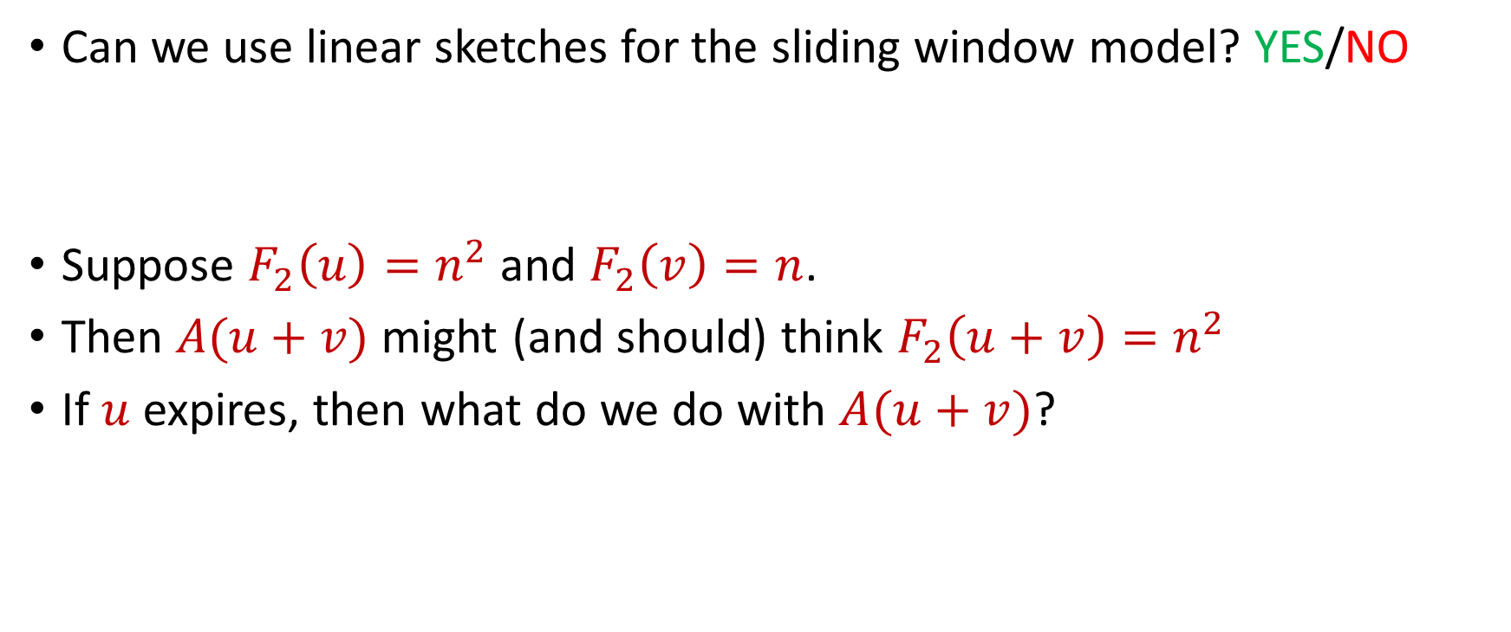
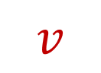
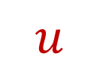
Sliding Window Model and Linear Sketches
Can we use linear sketches for the sliding window model? YES/NO
Suppose $F_{2}\left(u\right)=n^{2}$ and $F_{2}\left(v\right)=n$.
Then $A(u+v)$ might (and should) think $F_{2}\left(u+v\right)=n^{2}$
If $u$ expires, then what do we do with $A(u+v)$?
1 1 1 1 1 1 1 1 1 1 1 2 3 4 5 6 7 8 9 10 11
$$u$$
$$v$$
Notes:
The sliding window model emphasizes recent data and thus is appropriate for settings that are time sensitive.

Slide 20
Sliding Window Model and Sampling

Slide 21
Sliding Window Model and Sampling

Slide 22
Sliding Window Model and Sampling
Recall: we can sample each point with probability proportional to how “important” the point is

Slide 23
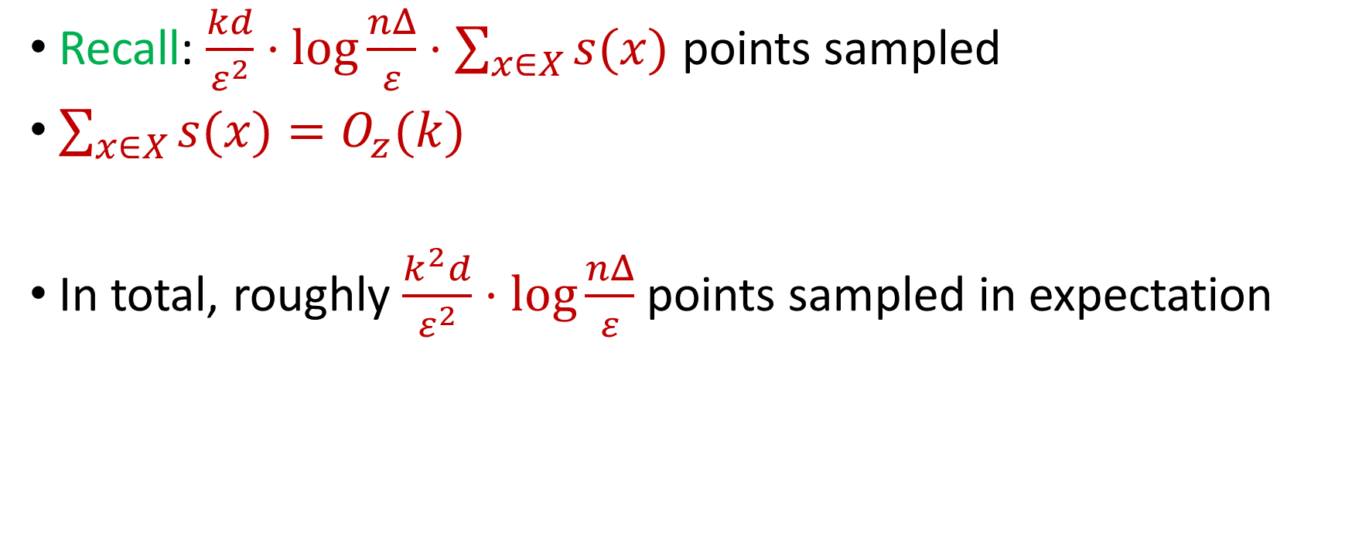
Last Time: Sensitivity Sampling
Recall: $\frac{kd}{ε^{2}}⋅\log{\frac{nΔ}{ε}}⋅\sum_{x∈X}{s(x)}$ points sampled
$\sum_{x∈X}{s(x)}=O_{z}(k)$
In total, roughly $\frac{k^{2}d}{ε^{2}}⋅\log{\frac{nΔ}{ε}}$ points sampled in expectation

Slide 24
Sliding Window Model and Sampling
Recall: we can sample each point with probability proportional to how “important” the point is
We can also consider the “importance” of each point with respect to the following points in the stream
Intuition: previous points do not matter in the importance of a point because the previous points can be expired

Slide 25
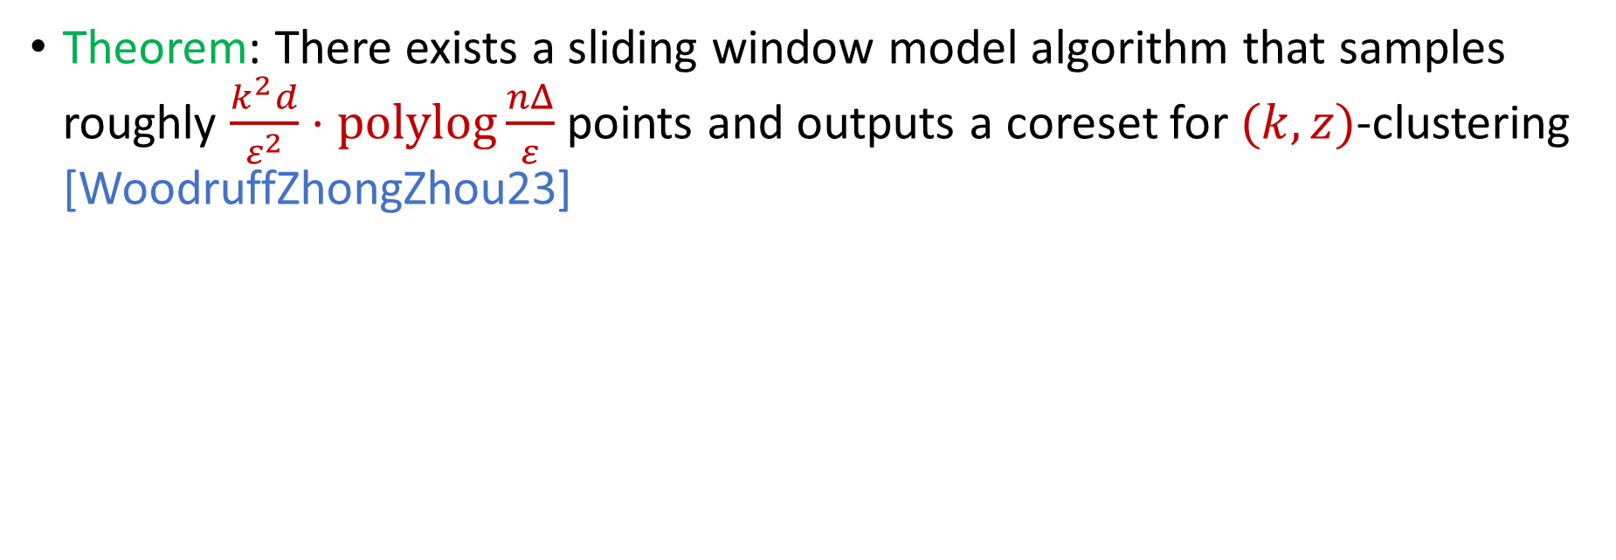
Sliding Window Model and Sampling
Theorem: There exists a sliding window model algorithm that samples roughly $\frac{k^{2}d}{ε^{2}}⋅\operatorname{polylog}{\frac{nΔ}{ε}}$ points and outputs a coreset for $(k,z)$-clustering [WoodruffZhongZhou23]

Slide 26
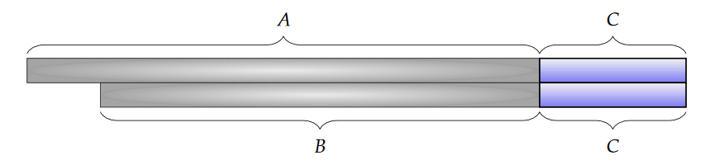
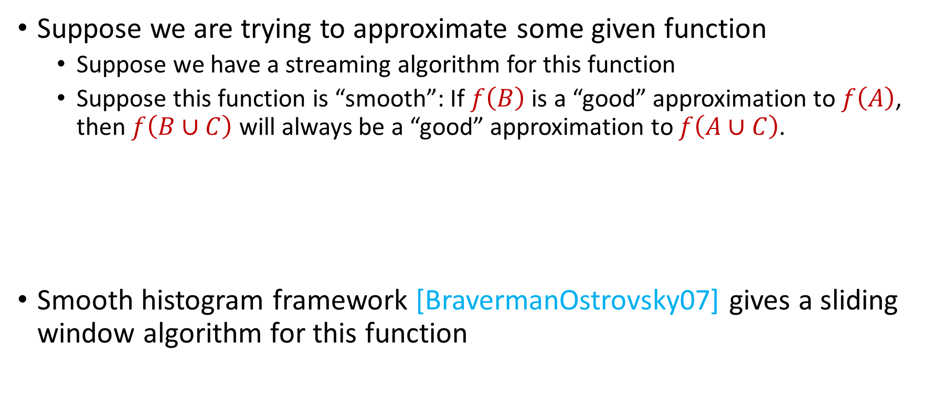
Sliding Window Algorithms
Suppose we are trying to approximate some given function
Suppose we have a streaming algorithm for this function
Suppose this function is “smooth”: If $f\left(B\right)$ is a “good” approximation to $f\left(A\right)$, then $f\left(B∪C\right)$ will always be a “good” approximation to $f\left(A∪C\right)$.
Smooth histogram framework [BravermanOstrovsky07] gives a sliding window algorithm for this function

Slide 27
Smooth Histogram
Suppose we are trying to approximate some given function
Smooth histogram framework [BO07] gives a sliding window algorithm for this function
Start a new instance of the streaming algorithm (along with existing instances) each time a new element arrives
Each time there are three instances that report “close” values, delete the middle one
Use different checkpoints to “sandwich” the sliding window

Slide 28
Smooth Histogram
Start a new instance of the streaming algorithm (along with existing instances) each time a new element arrives
Each time there are three instances that report “close” values, delete the middle one
Use different checkpoints to “sandwich” the sliding window
1
Example: Number of ones in sliding window (2-approximation)
1

Slide 29
Smooth Histogram
Start a new instance of the streaming algorithm (along with existing instances) each time a new element arrives
Each time there are three instances that report “close” values, delete the middle one
Use different checkpoints to “sandwich” the sliding window
1 0
Example: Number of ones in sliding window (2-approximation)
1
0

Slide 30
Smooth Histogram
Start a new instance of the streaming algorithm (along with existing instances) each time a new element arrives
Each time there are three instances that report “close” values, delete the middle one
Use different checkpoints to “sandwich” the sliding window
1 0 1
Example: Number of ones in sliding window (2-approximation)
2
1
1

Slide 31
Smooth Histogram
Start a new instance of the streaming algorithm (along with existing instances) each time a new element arrives
Each time there are three instances that report “close” values, delete the middle one
Use different checkpoints to “sandwich” the sliding window
1 0 1
Example: Number of ones in sliding window (2-approximation)
2
1

Slide 32
Smooth Histogram
Start a new instance of the streaming algorithm (along with existing instances) each time a new element arrives
Each time there are three instances that report “close” values, delete the middle one
Use different checkpoints to “sandwich” the sliding window
1 0 1
Example: Number of ones in sliding window (2-approximation)
2
1

Slide 33
Smooth Histogram
Start a new instance of the streaming algorithm (along with existing instances) each time a new element arrives
Each time there are three instances that report “close” values, delete the middle one
Use different checkpoints to “sandwich” the sliding window
1 0 1 1
Example: Number of ones in sliding window (2-approximation)
3
2
1

Slide 34
Smooth Histogram
Start a new instance of the streaming algorithm (along with existing instances) each time a new element arrives
Each time there are three instances that report “close” values, delete the middle one
Use different checkpoints to “sandwich” the sliding window
1 0 1 1 1
Example: Number of ones in sliding window (2-approximation)
4
3
2
1

Slide 35
Smooth Histogram
Start a new instance of the streaming algorithm (along with existing instances) each time a new element arrives
Each time there are three instances that report “close” values, delete the middle one
Use different checkpoints to “sandwich” the sliding window
1 0 1 1 1
Example: Number of ones in sliding window (2-approximation)
4
2
1

Slide 36
Smooth Histogram
Start a new instance of the streaming algorithm (along with existing instances) each time a new element arrives
Each time there are three instances that report “close” values, delete the middle one
Use different checkpoints to “sandwich” the sliding window
1 0 1 1 1 0 0 1 1 0 1
Example: Number of ones in sliding window (2-approximation)
7
4
2
1

Slide 37
Smooth Histogram
Start a new instance of the streaming algorithm (along with existing instances) each time a new element arrives
Each time there are three instances that report “close” values, delete the middle one
Use different checkpoints to “sandwich” the sliding window
1 0 1 1 1 0 0 1 1 0 1
Example: Number of ones in sliding window (2-approximation)
Number of ones in sliding window is at least 4 and at most 7
4 is a good approximation
7
4
2
1

Slide 38
Smooth Histogram
Converts a streaming algorithm for a smooth function into a sliding window algorithm

Slide 39


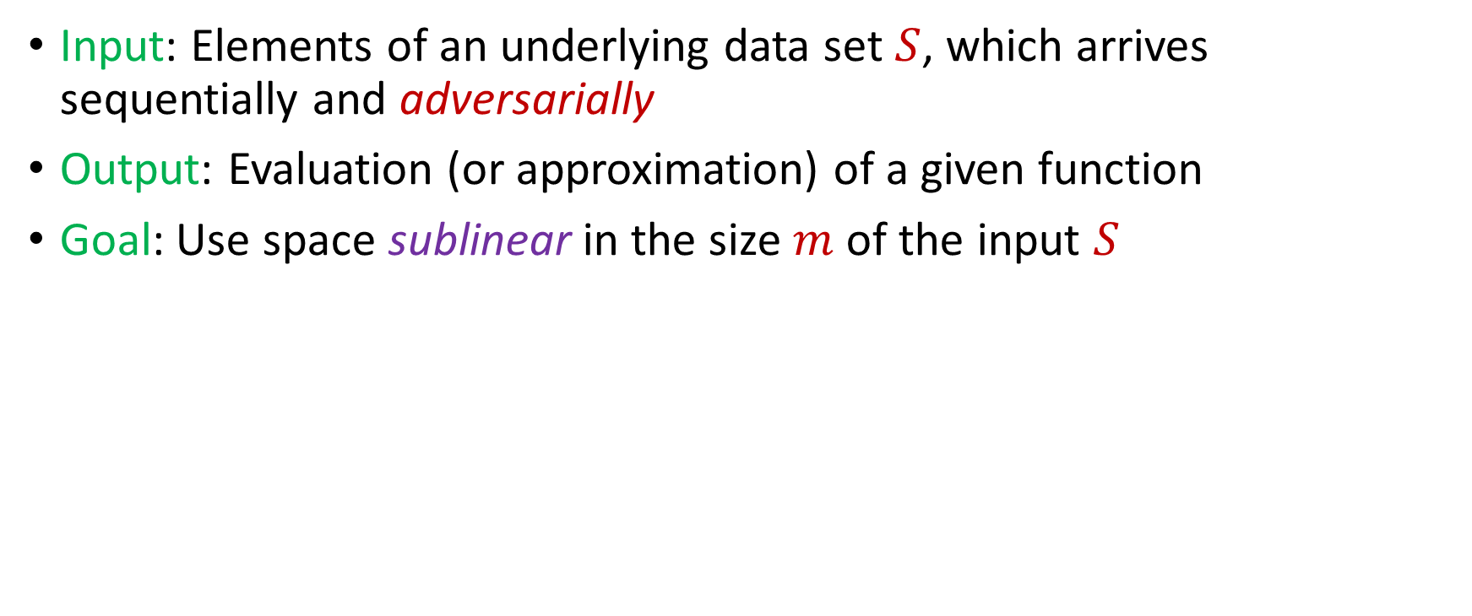
Adversarially Robust Streaming
Input: Elements of an underlying data set $S$, which arrives sequentially and adversarially
Output: Evaluation (or approximation) of a given function
Goal: Use space sublinear in the size $m$of the input $S$
1
1
Notes:
Let’s start by breaking down each of the terms in the title. To understand the sliding window model, we first have to understand the streaming model of computation, in which elements of an underlying data set S, arrive sequentially and the goal is to evaluate or approximate some given function on this dataset, using space sublinear in S. In the sliding window model, only the W most recent updates form the underlying data set

Slide 40
Adversarially Robust Streaming
Input: Elements of an underlying data set $S$, which arrives sequentially and adversarially
Output: Evaluation (or approximation) of a given function
Goal: Use space sublinear in the size $m$of the input $S$
10
1
Notes:
Let’s start by breaking down each of the terms in the title. To understand the sliding window model, we first have to understand the streaming model of computation, in which elements of an underlying data set S, arrive sequentially and the goal is to evaluate or approximate some given function on this dataset, using space sublinear in S. In the sliding window model, only the W most recent updates form the underlying data set

Slide 41
Adversarially Robust Streaming
Input: Elements of an underlying data set $S$, which arrives sequentially and adversarially
Output: Evaluation (or approximation) of a given function
Goal: Use space sublinear in the size $m$of the input $S$
101
2
Notes:
Let’s start by breaking down each of the terms in the title. To understand the sliding window model, we first have to understand the streaming model of computation, in which elements of an underlying data set S, arrive sequentially and the goal is to evaluate or approximate some given function on this dataset, using space sublinear in S. In the sliding window model, only the W most recent updates form the underlying data set

Slide 42
Adversarially Robust Streaming
Input: Elements of an underlying data set $S$, which arrives sequentially and adversarially
Output: Evaluation (or approximation) of a given function
Goal: Use space sublinear in the size $m$of the input $S$
1010
3
Notes:
Let’s start by breaking down each of the terms in the title. To understand the sliding window model, we first have to understand the streaming model of computation, in which elements of an underlying data set S, arrive sequentially and the goal is to evaluate or approximate some given function on this dataset, using space sublinear in S. In the sliding window model, only the W most recent updates form the underlying data set

Slide 43

Adversarially Robust Streaming
Input: Elements of an underlying data set $S$, which arrives sequentially and adversarially
Output: Evaluation (or approximation) of a given function
Goal: Use space sublinear in the size $m$of the input $S$
1010
3
Notes:
Let’s start by breaking down each of the terms in the title. To understand the sliding window model, we first have to understand the streaming model of computation, in which elements of an underlying data set S, arrive sequentially and the goal is to evaluate or approximate some given function on this dataset, using space sublinear in S. In the sliding window model, only the W most recent updates form the underlying data set

Slide 44
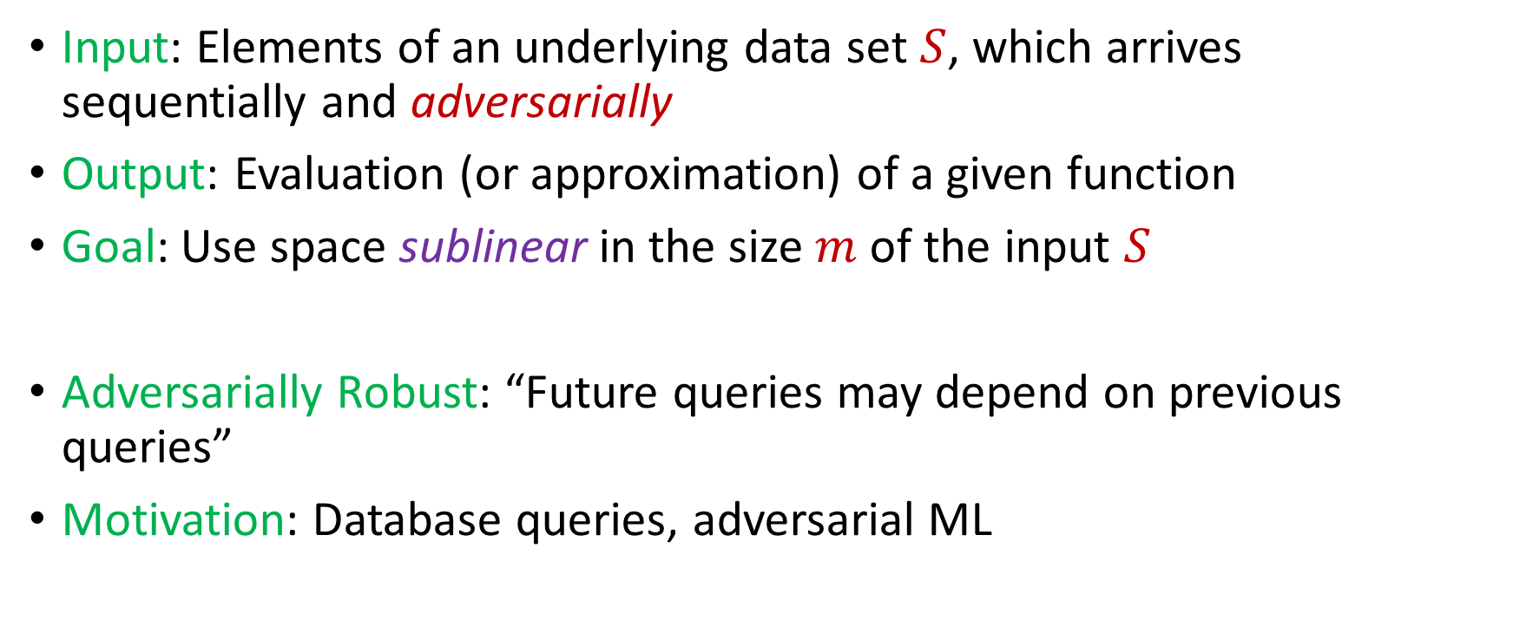
Adversarially Robust Streaming
Input: Elements of an underlying data set $S$, which arrives sequentially and adversarially
Output: Evaluation (or approximation) of a given function
Goal: Use space sublinear in the size $m$of the input $S$
Adversarially Robust: “Future queries may depend on previous queries”
Motivation: Database queries, adversarial ML
Notes:
Let’s start by breaking down each of the terms in the title. To understand the sliding window model, we first have to understand the streaming model of computation, in which elements of an underlying data set S, arrive sequentially and the goal is to evaluate or approximate some given function on this dataset, using space sublinear in S. In the sliding window model, only the W most recent updates form the underlying data set

Slide 45

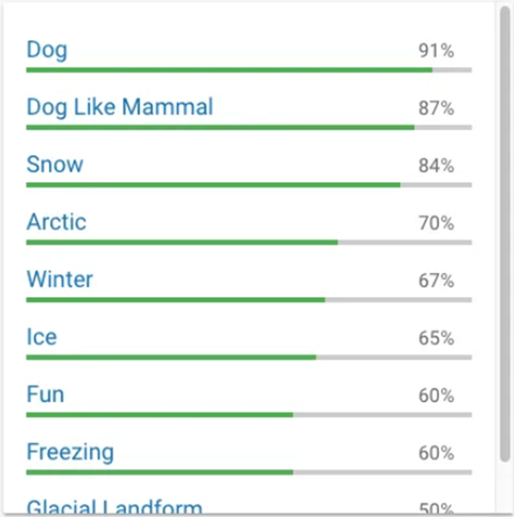
Human readers will easily identify the image as showing two men on skis. Google’s Cloud Vision service reported being 91 percent certain it saw a dog. Other stunts have shown how to make stop signs invisible, or audio that sounds benign to humans but is transcribed by software as “OK Google browse to evil dot com.”

Slide 46
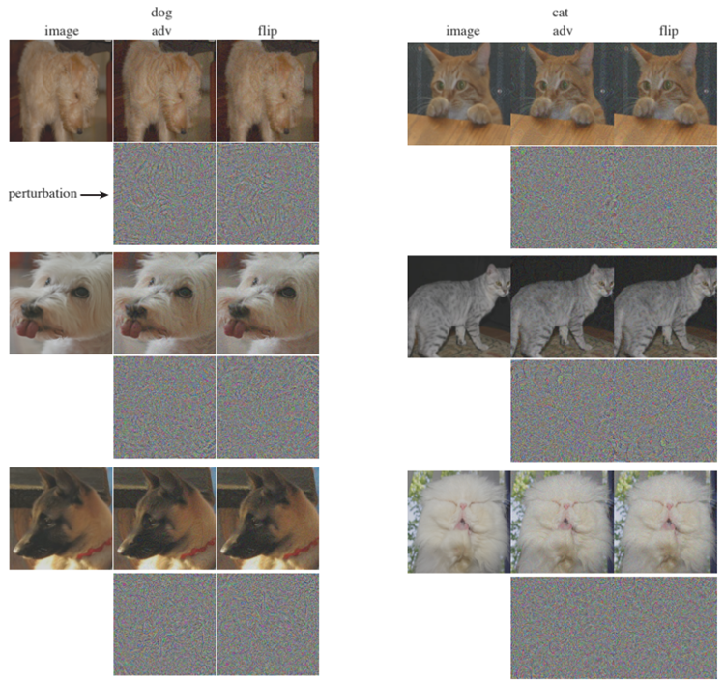

Slide 47
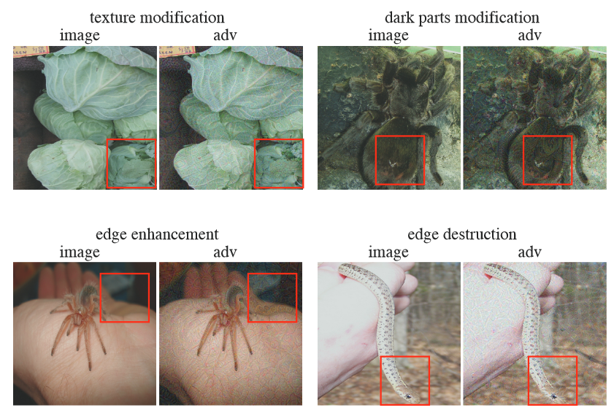

Slide 48
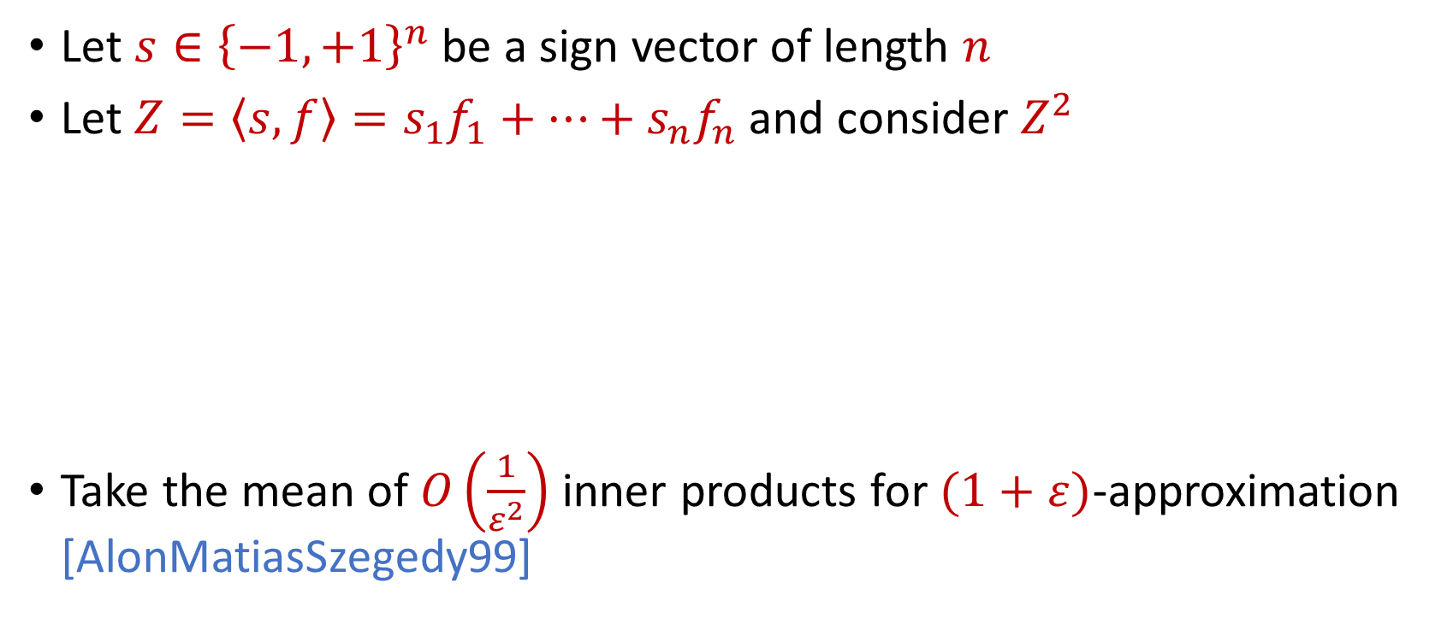

AMS $F_{2}$Algorithm
Let $s∈{\left\{−1,+1\right\}}^{n}$ be a sign vector of length $n$
Let $Z=\left\langle s,f\right\rangle =s_{1}f_{1}+…+s_{n}f_{n}$ and consider $Z^{2}$
Take the mean of $O\left(\frac{1}{ε^{2}}\right)$ inner products for $(1+ε)$-approximation [AlonMatiasSzegedy99]
$E\left[Z^{2}\right]=$ $\sum_{i,j}{E\left[s_{i}s_{j}f_{i}f_{j}\right]}=f_{1}^{2}+…+f_{n}^{2}$
$Var\left[Z^{2}\right]≤$ $\sum_{i,j}{E\left[s_{i}s_{j}s_{k}s_{l}f_{i}f_{j}f_{k}f_{l}\right]}≤2F_{2}^{2}$

Slide 49
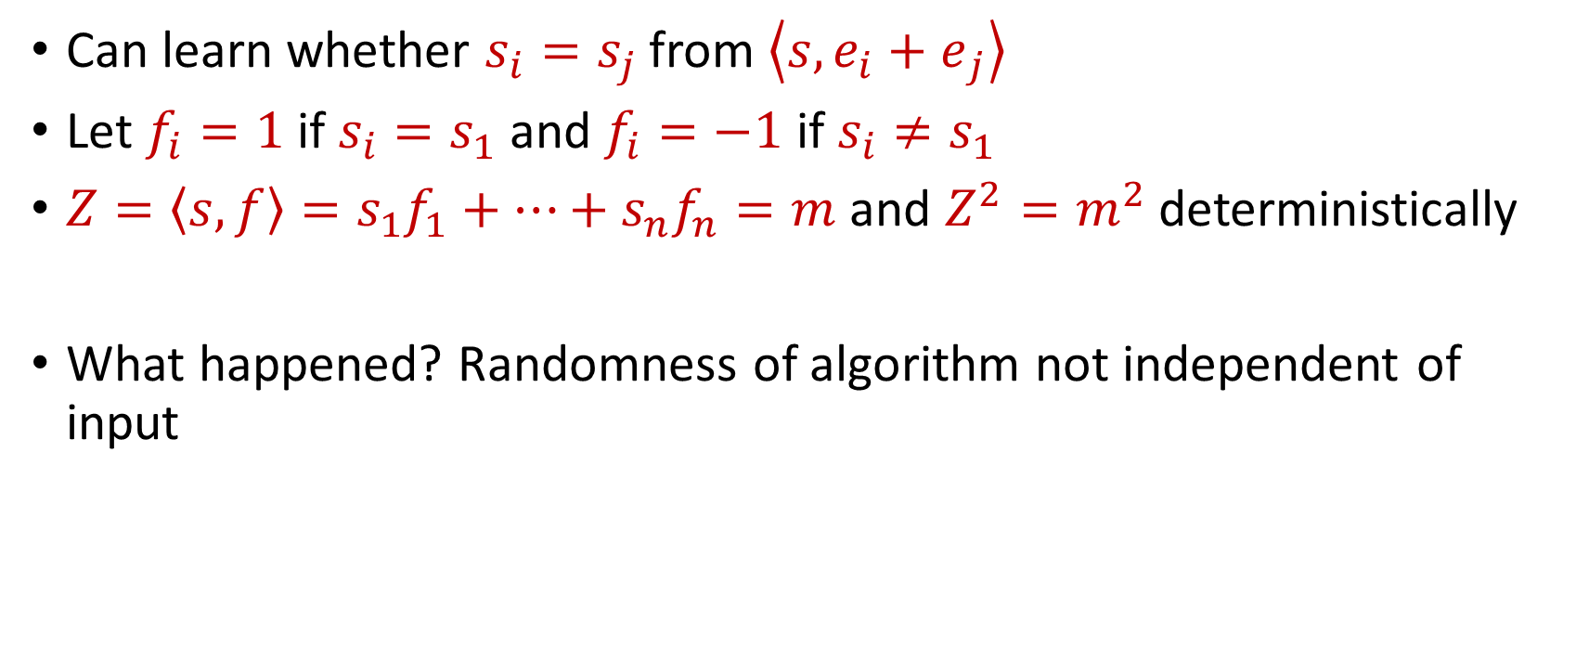
“Attack” on AMS
Can learn whether $s_{i}=s_{j}$ from $\left\langle s,{e_{i}+e}_{j}\right\rangle$
Let $f_{i}=1$ if $s_{i}=s_{1}$ and $f_{i}=−1$ if $s_{i}≠s_{1}$
$Z=\left\langle s,f\right\rangle =s_{1}f_{1}+…+s_{n}f_{n}=m$ and $Z^{2}=m^{2}$ deterministically
What happened? Randomness of algorithm not independent of input

Slide 50
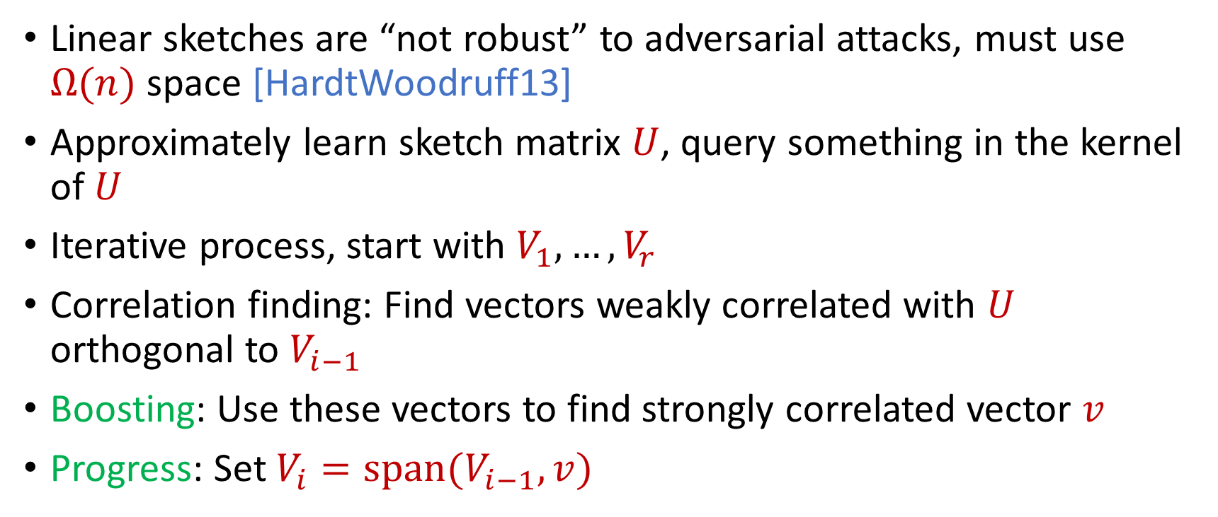
Reconstruction Attack on Linear Sketches
Linear sketches are “not robust” to adversarial attacks, must use $Ω(n)$ space [HardtWoodruff13]
Approximately learn sketch matrix $U$, query something in the kernel of $U$
Iterative process, start with $V_{1},…,V_{r}$
Correlation finding: Find vectors weakly correlated with $U$ orthogonal to $V_{i−1}$
Boosting: Use these vectors to find strongly correlated vector $v$
Progress: Set $V_{i}=span(V_{i−1},v)$

Slide 51
Insertion-Only Streams
Key: Deletions are needed to perform this attack
Similar lower bounds for the sliding window model [DatarGionisIndykMotwani02]
Assume insertion-only updates
How do the previous results work?

Slide 52
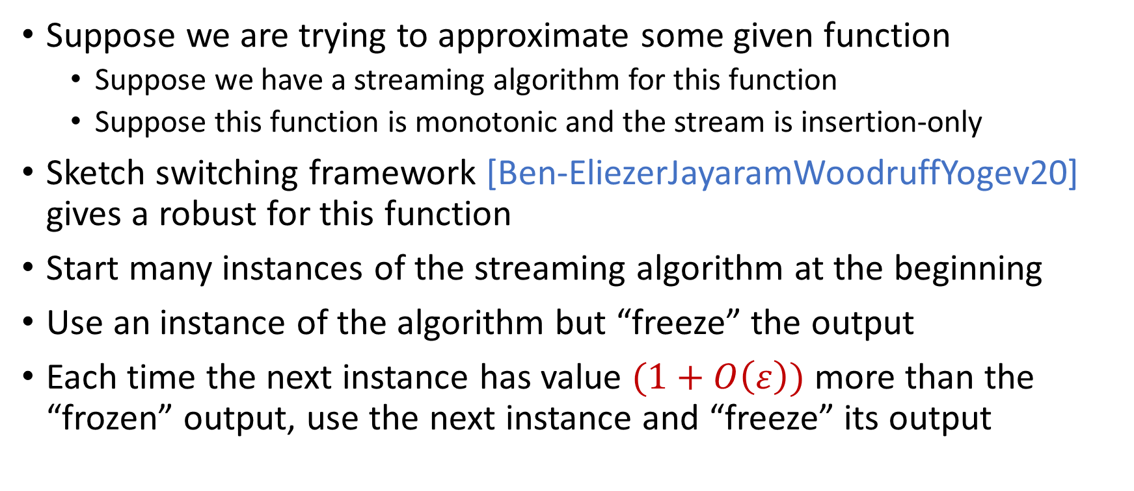
Robust Algorithms
Suppose we are trying to approximate some given function
Suppose we have a streaming algorithm for this function
Suppose this function is monotonic and the stream is insertion-only
Sketch switching framework [Ben-EliezerJayaramWoodruffYogev20] gives a robust for this function
Start many instances of the streaming algorithm at the beginning
Use an instance of the algorithm but “freeze” the output
Each time the next instance has value $(1+O\left(ε\right))$ more than the “frozen” output, use the next instance and “freeze” its output

Slide 53
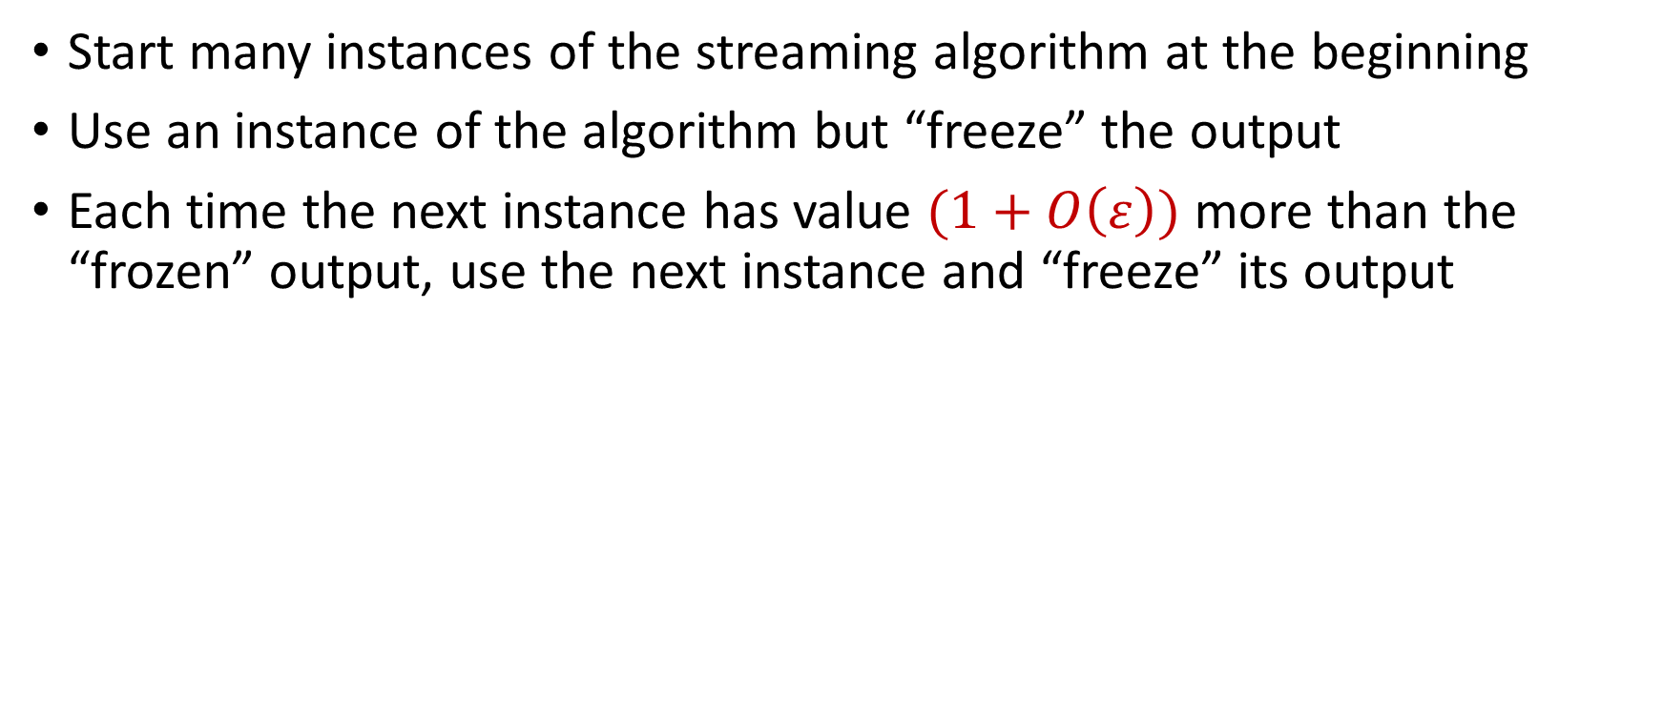
Sketch Switching
Start many instances of the streaming algorithm at the beginning
Use an instance of the algorithm but “freeze” the output
Each time the next instance has value $(1+O\left(ε\right))$ more than the “frozen” output, use the next instance and “freeze” its output
1
Example: Number of ones in the stream (2-approximation)
1
1
1
1

Slide 54

Sketch Switching
Start many instances of the streaming algorithm at the beginning
Use an instance of the algorithm but “freeze” the output
Each time the next instance has value $(1+O\left(ε\right))$ more than the “frozen” output, use the next instance and “freeze” its output
1 0
Example: Number of ones in the stream (2-approximation)
1
1
1
1

Slide 55
Sketch Switching
Start many instances of the streaming algorithm at the beginning
Use an instance of the algorithm but “freeze” the output
Each time the next instance has value $(1+O\left(ε\right))$ more than the “frozen” output, use the next instance and “freeze” its output
1 0 1
Example: Number of ones in the stream (2-approximation)
1
2
2
2

Slide 56
Sketch Switching
Start many instances of the streaming algorithm at the beginning
Use an instance of the algorithm but “freeze” the output
Each time the next instance has value $(1+O\left(ε\right))$ more than the “frozen” output, use the next instance and “freeze” its output
1 0 1
Example: Number of ones in the stream (2-approximation)
1
2
2
2

Slide 57
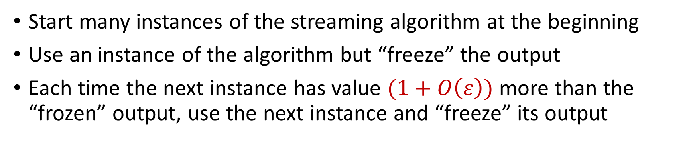
Sketch Switching
Start many instances of the streaming algorithm at the beginning
Use an instance of the algorithm but “freeze” the output
Each time the next instance has value $(1+O\left(ε\right))$ more than the “frozen” output, use the next instance and “freeze” its output
1 0 1 1
Example: Number of ones in the stream (2-approximation)
1
2
3
3

Slide 58
Sketch Switching
Start many instances of the streaming algorithm at the beginning
Use an instance of the algorithm but “freeze” the output
Each time the next instance has value $(1+O\left(ε\right))$ more than the “frozen” output, use the next instance and “freeze” its output
1 0 1 1 1
Example: Number of ones in the stream (2-approximation)
1
2
4
4

Slide 59
Sketch Switching
Start many instances of the streaming algorithm at the beginning
Use an instance of the algorithm but “freeze” the output
Each time the next instance has value $(1+O\left(ε\right))$ more than the “frozen” output, use the next instance and “freeze” its output
1 0 1 1 1
Example: Number of ones in the stream (2-approximation)
1
2
4
4

Slide 60
Sketch Switching
Start many instances of the streaming algorithm at the beginning
Use an instance of the algorithm but “freeze” the output
Each time the next instance has value $(1+O\left(ε\right))$ more than the “frozen” output, use the next instance and “freeze” its output
1 0 1 1 1 0 0 1 1 0 1
Example: Number of ones in the stream (2-approximation)
Number of ones stream is at least 4 and at most 8
4 is a good approximation
1
2
4
7

Slide 61
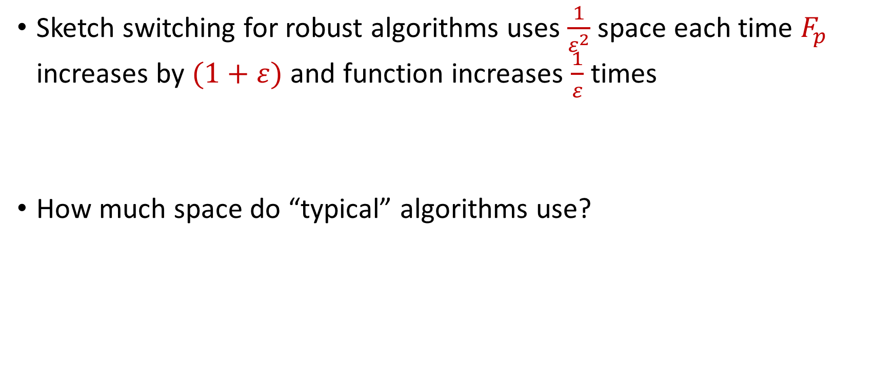
Sketch Switching Summary
Sketch switching for robust algorithms uses $\frac{1}{ε^{2}}$ space each time $F_{p}$ increases by $(1+ε)$ and function increases $\frac{1}{ε}$ times
How much space do “typical” algorithms use?

Slide 62
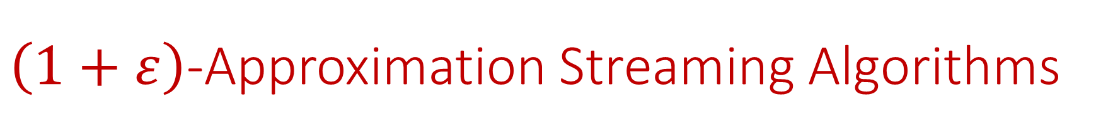
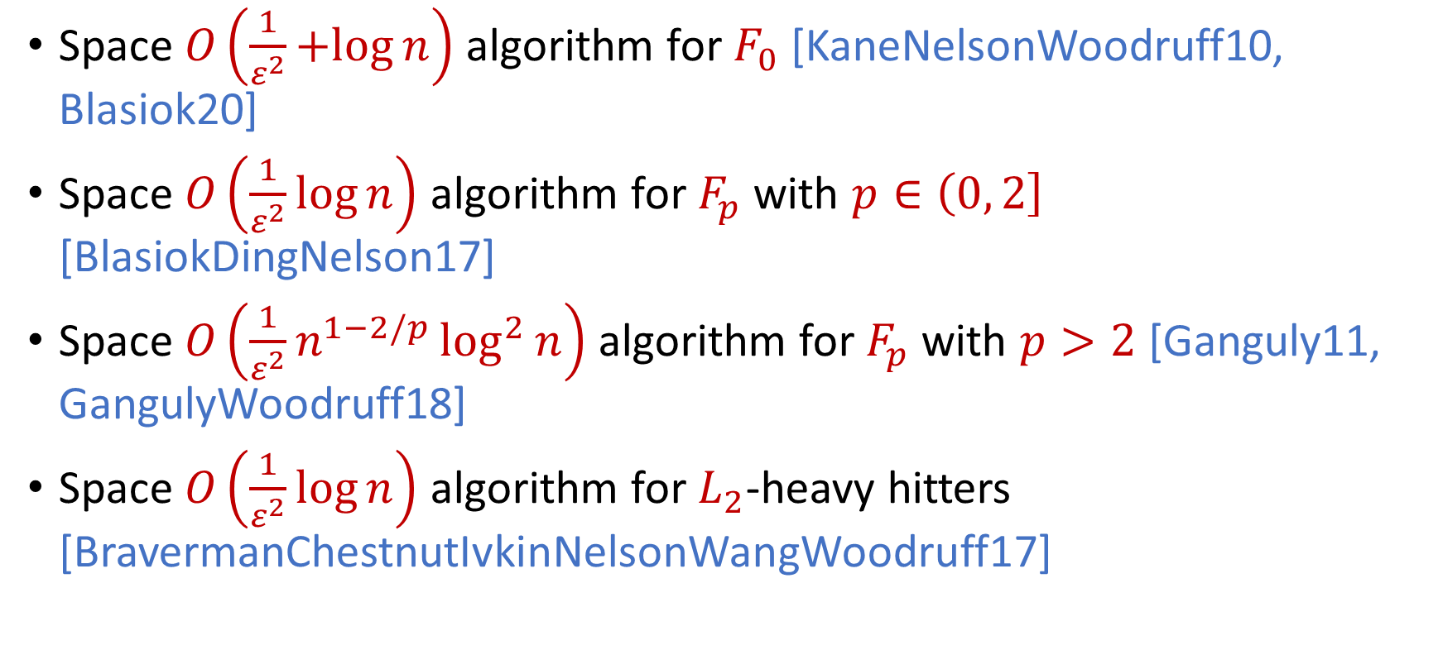
$\left(1+ε\right)$-Approximation Streaming Algorithms
Space $O\left(\frac{1}{ε^{2}}+log{n}\right)$ algorithm for $F_{0}$ [KaneNelsonWoodruff10, Blasiok20]
Space $O\left(\frac{1}{ε^{2}}\log{n}\right)$ algorithm for $F_{p}$ with $p∈\left(0, 2\right]$ [BlasiokDingNelson17]
Space $O\left(\frac{1}{ε^{2}}n^{1−2/p}\log^{2}{n}\right)$ algorithm for $F_{p}$ with $p>2$ [Ganguly11, GangulyWoodruff18]
Space $O\left(\frac{1}{ε^{2}}\log{n}\right)$ algorithm for $L_{2}$-heavy hitters [BravermanChestnutIvkinNelsonWangWoodruff17]

Slide 63
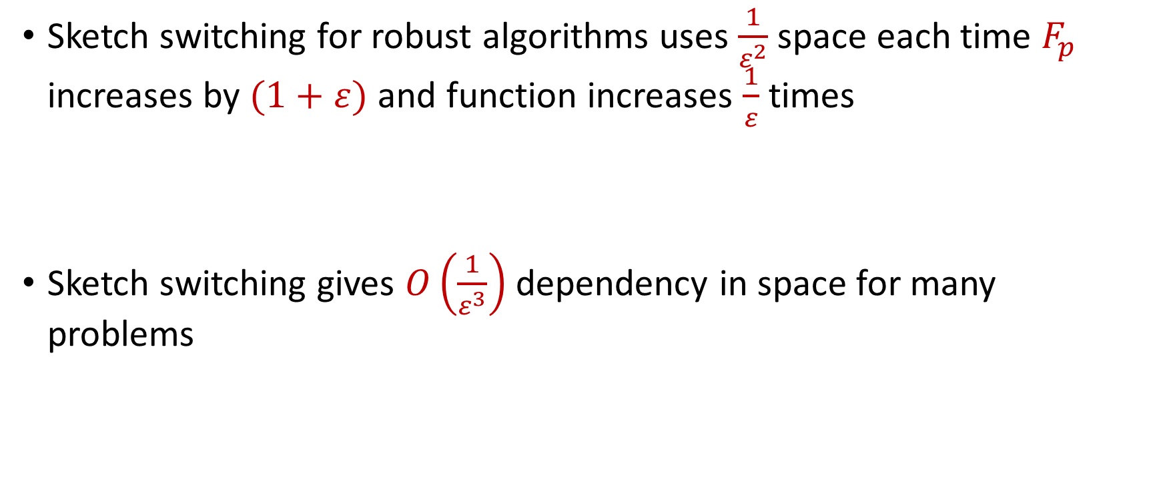
Sketch Switching Summary
Sketch switching for robust algorithms uses $\frac{1}{ε^{2}}$ space each time $F_{p}$ increases by $(1+ε)$ and function increases $\frac{1}{ε}$ times
Sketch switching gives $O\left(\frac{1}{ε^{3}}\right)$ dependency in space for many problems

Slide 64
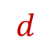

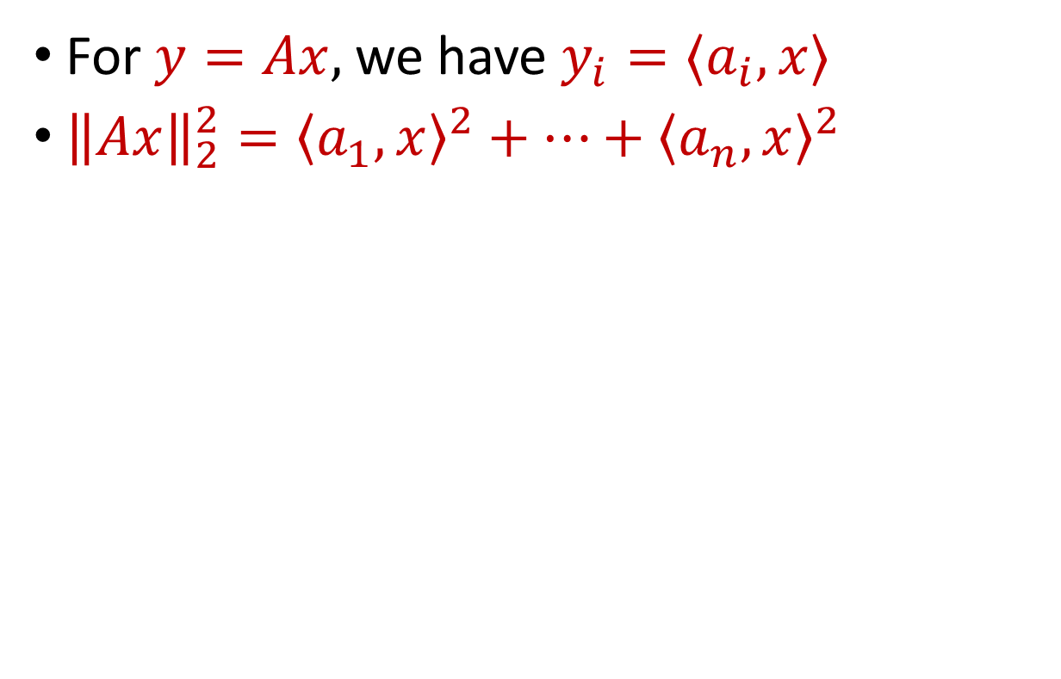
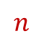
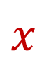

Linear Algebra Review
For $y=Ax$, we have $y_{i}=⟨a_{i}, x⟩$
${\left\|Ax\right\|}_{2}^{2}={\left\langle a_{1}, x\right\rangle }^{2}+…+{\left\langle a_{n}, x\right\rangle }^{2}$
$$A$$
$$x$$
$$d$$
$$n$$
$$d$$

Slide 65
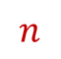
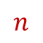
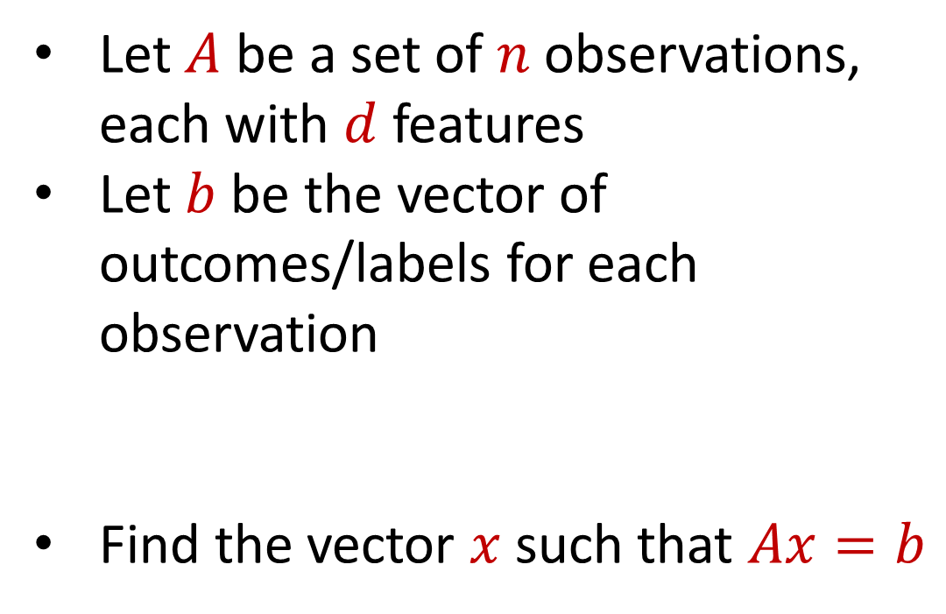
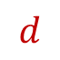
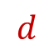
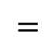
Regression
Let $A$ be a set of $n$ observations, each with $d$ features
Let $b$ be the vector of outcomes/labels for each observation
Find the vector $x$ such that $Ax=b$
$$d$$
$$x$$
$$=$$
$$n$$
$$A$$
$$n$$
$$b$$
$$1$$
$$d$$
$$1$$

Slide 66
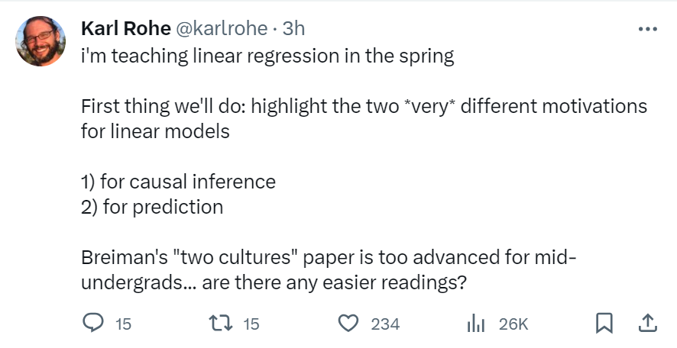

Slide 67


Regression
Economics and Finance:
Stock price prediction: Predict stock prices based on historical data and other relevant factors.
Econometric analysis: Study the relationships between economic variables like GDP, inflation, and interest rates.

Slide 68

Regression
Medicine and Healthcare:
Medical research: Understand the relationship between factors such as age, genetics, and lifestyle on health outcomes.
Disease prediction: Predicting the probability of disease occurrence based on risk factors like smoking, diet, and exercise.

Slide 69
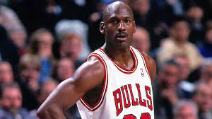

Regression
Sports Analytics:
Player performance forecast: Predicting player performance in sports like baseball, basketball, or soccer based on historical data.
Game outcome prediction: Predicting the outcome of games based on team statistics and other factors.

Slide 70

Regression
Environmental Science:
Climate modeling: Model climate change variables like temperature, precipitation, and sea levels.
Pollution analysis: Analyze the relationship between pollution levels and various factors like industrial activity and population.

Slide 71
Regression
Let $A$ be a set of $n$ observations, each with $d$ features
Let $b$ be the vector of outcomes/labels for each observation
Find the vector $x$ such that $Ax=b$
$$d$$
$$x$$
$$=$$
$$n$$
$$A$$
$$n$$
$$b$$
$$1$$
$$d$$
$$1$$

Slide 72
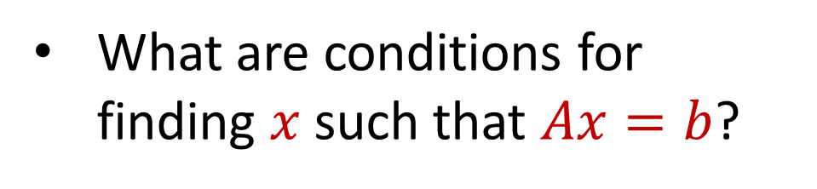
Linear Algebra Review
What are conditions for finding $x$ such that $Ax=b$?
$$d$$
$$x$$
$$=$$
$$n$$
$$A$$
$$n$$
$$b$$
$$1$$
$$d$$
$$1$$

Slide 73
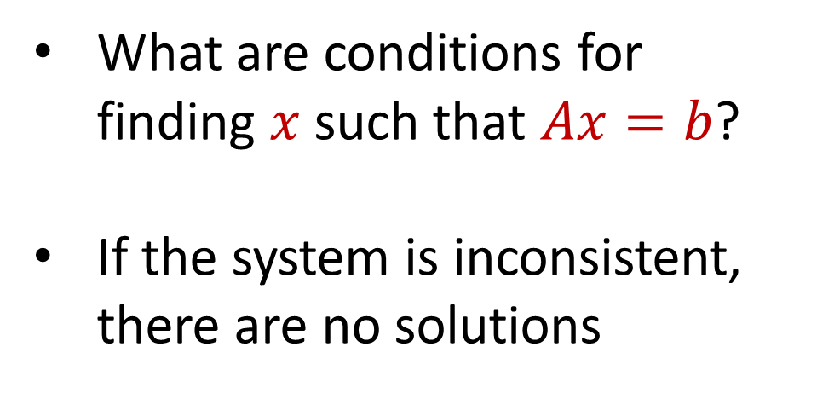
Linear Algebra Review
What are conditions for finding $x$ such that $Ax=b$?
If the system is inconsistent, there are no solutions
$$d$$
$$x$$
$$=$$
$$n$$
$$A$$
$$n$$
$$b$$
$$1$$
$$d$$
$$1$$

Slide 74
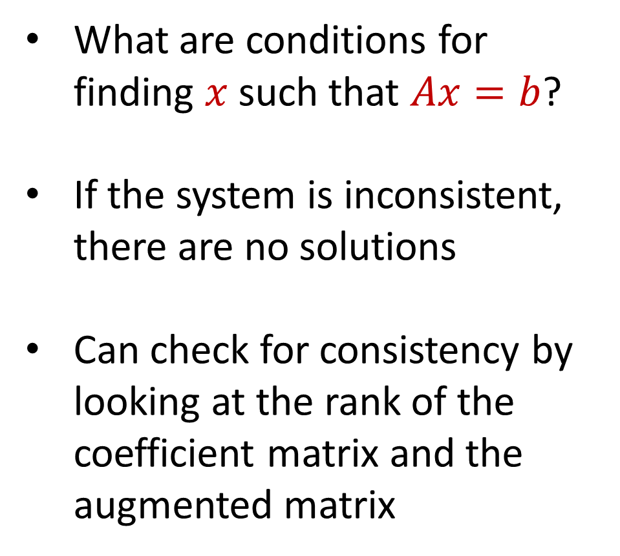
Linear Algebra Review
What are conditions for finding $x$ such that $Ax=b$?
If the system is inconsistent, there are no solutions
Can check for consistency by looking at the rank of the coefficient matrix and the augmented matrix
$$d$$
$$x$$
$$=$$
$$n$$
$$A$$
$$n$$
$$b$$
$$1$$
$$d$$
$$1$$

Slide 75
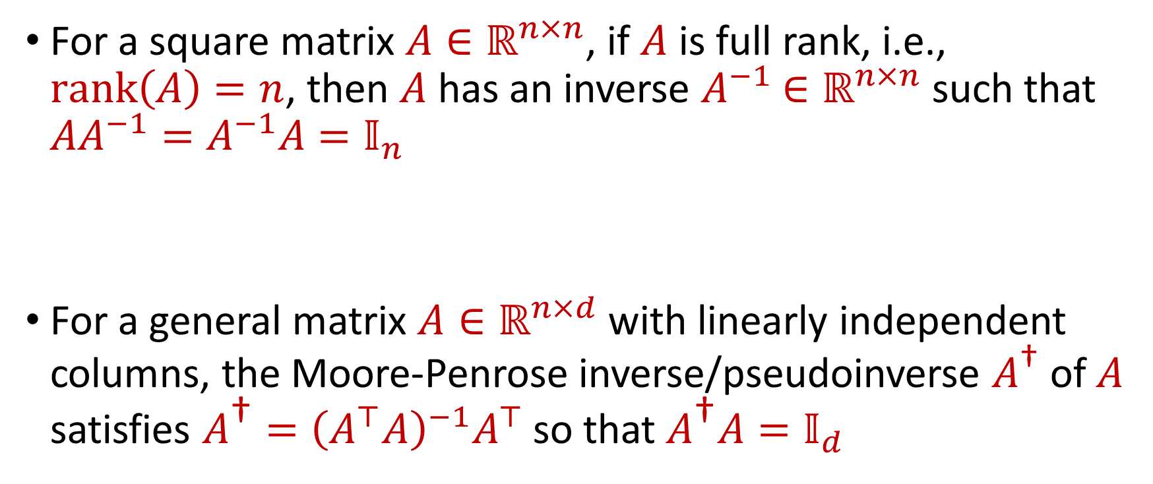
Linear Algebra Review
For a square matrix $A∈ℝ^{n×n}$, if $A$ is full rank, i.e., $rank\left(A\right)=n$, then $A$ has an inverse $A^{−1}$ $∈ℝ^{n×n}$ such that $AA^{−1}=A^{−1}A=𝕀_{n}$
For a general matrix $A∈ℝ^{n×d}$ with linearly independent columns, the Moore-Penrose inverse/pseudoinverse $A^{\text{†}}$ of $A$ satisfies $A^{\text{†}}={\left(A^{⊤}A\right)}^{−1}A^{⊤}$ so that $A^{\text{†}}A=𝕀_{d}$

Slide 76
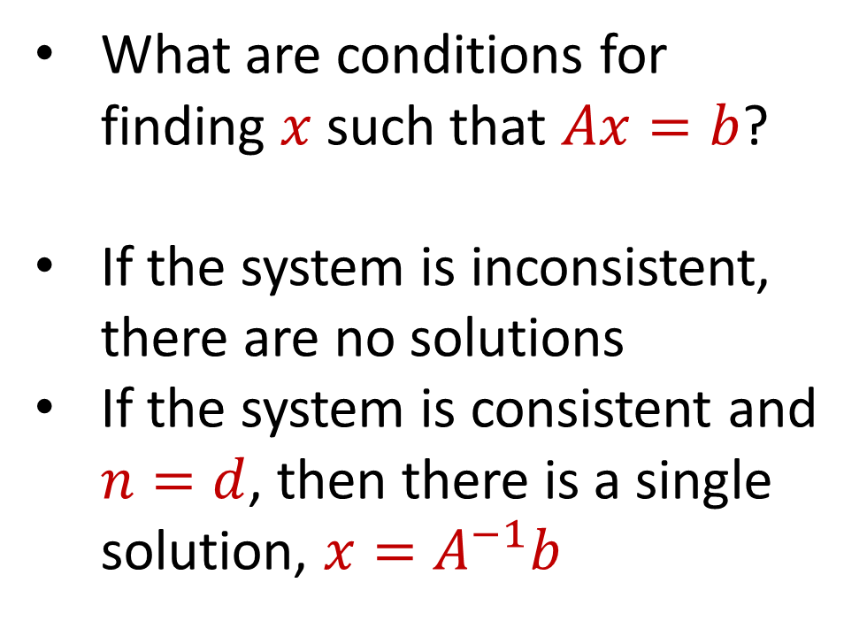
Linear Algebra Review
What are conditions for finding $x$ such that $Ax=b$?
If the system is inconsistent, there are no solutions
If the system is consistent and $n=d$, then there is a single solution, $x=A^{−1}b$
$$d$$
$$x$$
$$=$$
$$n$$
$$A$$
$$n$$
$$b$$
$$1$$
$$d$$
$$1$$

Slide 77
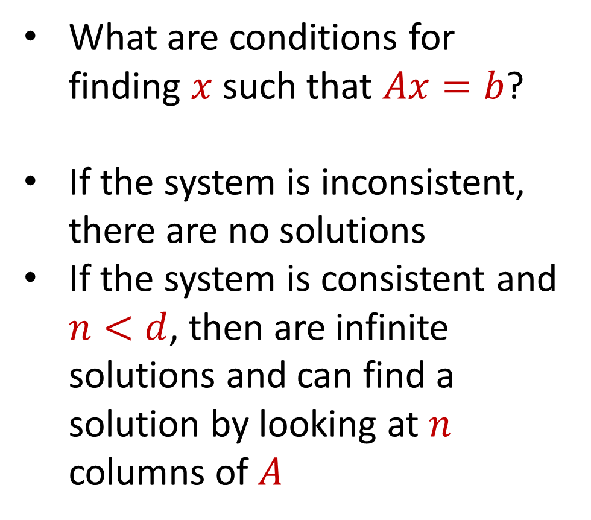
Linear Algebra Review
What are conditions for finding $x$ such that $Ax=b$?
If the system is inconsistent, there are no solutions
If the system is consistent and $n<d$, then are infinite solutions and can find a solution by looking at $n$ columns of $A$
$$d$$
$$x$$
$$=$$
$$n$$
$$A$$
$$n$$
$$b$$
$$1$$
$$d$$
$$1$$

Slide 78
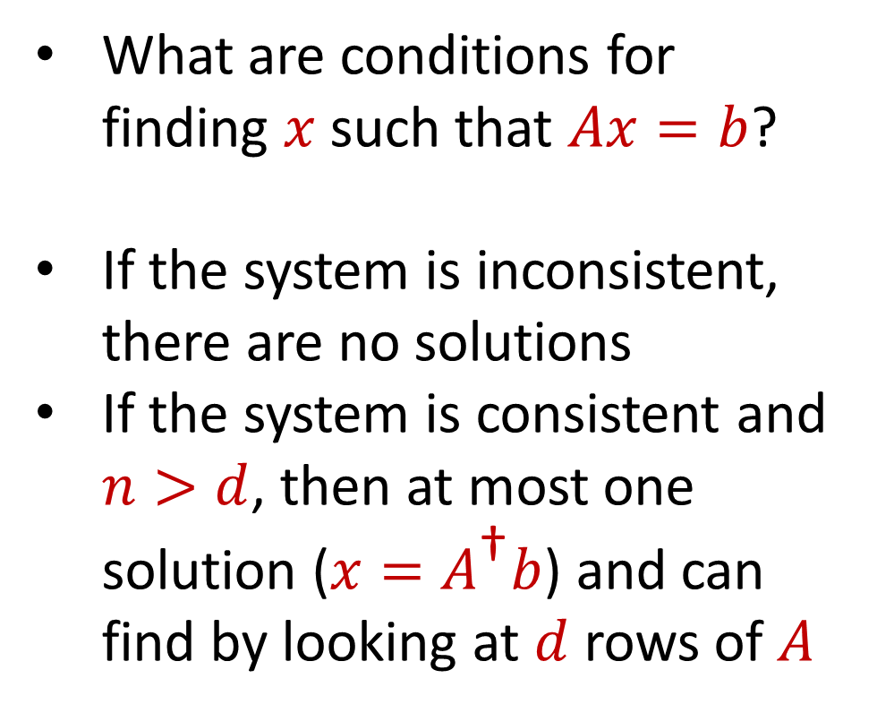
Linear Algebra Review
What are conditions for finding $x$ such that $Ax=b$?
If the system is inconsistent, there are no solutions
If the system is consistent and $n>d$, then at most one solution ($x=A^{\text{†}}b$) and can find by looking at $d$ rows of $A$
$$d$$
$$x$$
$$=$$
$$n$$
$$A$$
$$n$$
$$b$$
$$1$$
$$d$$
$$1$$

Slide 79

Regression
What are conditions for finding $x$ such that $Ax=b$?
What to do when there is no $x$ such that $Ax=b$?
$$d$$
$$x$$
$$=$$
$$n$$
$$A$$
$$n$$
$$b$$
$$1$$
$$d$$
$$1$$

Slide 80

Regression
What are conditions for finding $x$ such that $Ax=b$?
What to do when there is no $x$ such that $Ax=b$?
Minimize $ℒ(Ax−b)$ for some loss function $ℒ$
$$d$$
$$x$$
$$=$$
$$n$$
$$A$$
$$n$$
$$b$$
$$1$$
$$d$$
$$1$$

Slide 81


Linear Regression
Find the vector $x$ that minimizes ${\left\|Ax−b\right\|}_{2}$
“Least squares” optimization
$$d$$
$$x$$
$$≈$$
$$n$$
$$A$$
$$n$$
$$b$$
$$1$$
$$d$$
$$1$$

Slide 82

Linear Regression
Find the vector $x$ that minimizes ${\left\|Ax−b\right\|}_{2}$
What is the solution to $\min_{x∈ℝ^{d}} {\left\|Ax−b\right\|}_{2}$?
$$d$$
$$x$$
$$≈$$
$$n$$
$$A$$
$$n$$
$$b$$
$$1$$
$$d$$
$$1$$

Slide 83



Linear Regression
$$b=\left[\begin{aligned}5 \\ 5\end{aligned}\right]$$
$$A=\left[\begin{aligned}2 \\ 1\end{aligned}\right]$$
Find $x$ that minimizes ${\left\|Ax−b\right\|}_{2}$

Slide 84

Linear Regression
$$b=\left[\begin{aligned}5 \\ 5\end{aligned}\right]$$
$$\left[\begin{aligned}6 \\ 3\end{aligned}\right]$$
$$A=\left[\begin{aligned}2 \\ 1\end{aligned}\right]$$
Find $x$ that minimizes ${\left\|Ax−b\right\|}_{2}$

Slide 85

Linear Regression
Find the vector $x$ that minimizes ${\left\|Ax−b\right\|}_{2}$
What is the solution to $\min_{x∈ℝ^{d}} {\left\|Ax−b\right\|}_{2}$?
Let $b^{⊥}$ be the projection of $b$ onto the column space of $A$
Decompose $b$ into $b^{⊥}$ and $b^{∥}$
$$d$$
$$x$$
$$≈$$
$$n$$
$$A$$
$$n$$
$$b$$
$$1$$
$$d$$
$$1$$

Slide 86

Linear Regression
We have $\arg{\min_{x∈ℝ^{d}} {\left\|Ax−b\right\|}_{2} }=\arg{\min_{x∈ℝ^{d}} {\left\|Ax−b\right\|}_{2}^{2} }$
${\left\|Ax−b\right\|}_{2}^{2}={\left\|Ax−b^{⊥}−b^{∥}\right\|}_{2}^{2}$

Slide 87

Linear Regression
We have $\arg{\min_{x∈ℝ^{d}} {\left\|Ax−b\right\|}_{2} }=\arg{\min_{x∈ℝ^{d}} {\left\|Ax−b\right\|}_{2}^{2} }$
${\left\|Ax−b\right\|}_{2}^{2}={\left\|Ax−b^{⊥}−b^{∥}\right\|}_{2}^{2}$
$$={\left\|Ax−b^{∥}\right\|}_{2}^{2}−2\left\langle Ax−b^{∥},b^{⊥}\right\rangle +{\left\|b^{⊥}\right\|}_{2}^{2}$$

Slide 88

Linear Regression
We have $\arg{\min_{x∈ℝ^{d}} {\left\|Ax−b\right\|}_{2} }=\arg{\min_{x∈ℝ^{d}} {\left\|Ax−b\right\|}_{2}^{2} }$
${\left\|Ax−b\right\|}_{2}^{2}={\left\|Ax−b^{⊥}−b^{∥}\right\|}_{2}^{2}$
$$={\left\|Ax−b^{∥}\right\|}_{2}^{2}−2\left\langle Ax−b^{∥},b^{⊥}\right\rangle +{\left\|b^{⊥}\right\|}_{2}^{2}$$
$$={\left\|Ax−b^{∥}\right\|}_{2}^{2}+{\left\|b^{⊥}\right\|}_{2}^{2}$$

Slide 89

Linear Regression
We have $\arg{\min_{x∈ℝ^{d}} {\left\|Ax−b\right\|}_{2} }=\arg{\min_{x∈ℝ^{d}} {\left\|Ax−b\right\|}_{2}^{2} }$
${\left\|Ax−b\right\|}_{2}^{2}={\left\|Ax−b^{⊥}−b^{∥}\right\|}_{2}^{2}$
Minimized for ${\left\|Ax−b^{∥}\right\|}_{2}^{2}=0$ when $x=A^{\text{†}}b^{∥}=A^{\text{†}}b$
$$={\left\|Ax−b^{∥}\right\|}_{2}^{2}−2\left\langle Ax−b^{∥},b^{⊥}\right\rangle +{\left\|b^{⊥}\right\|}_{2}^{2}$$
$$={\left\|Ax−b^{∥}\right\|}_{2}^{2}+{\left\|b^{⊥}\right\|}_{2}^{2}$$

Slide 90

Linear Regression
Find the vector $x$ that minimizes ${\left\|Ax−b\right\|}_{2}$
“Least squares” optimization
MLE under Gaussian noise
Closed form solution: $x=A^{\text{†}}b$
$$d$$
$$x$$
$$≈$$
$$n$$
$$A$$
$$n$$
$$b$$
$$1$$
$$d$$
$$1$$

Slide 91


Subspace Embedding
Subspace embedding: Given $ε>0$ and $A∈R^{n×d}$, find matrix $M∈R^{m×d}$ with $m≪n$, such that for every $x∈ℝ^{d}$,
Equivalent to $\left(1−ε\right)A^{⊤}A≼M^{⊤}M≼\left(1+ε\right)A^{⊤}A$
Approximates all cuts of a graph when $A^{⊤}A$ is graph Laplacian
$$A$$
$$x$$
$$n$$
$$\left(1−ε\right){\left\|Ax\right\|}_{2}≤{\left\|Mx\right\|}_{2}≤\left(1+ε\right){\left\|Ax\right\|}_{2}$$
$$d$$

Slide 92

Subspace Embedding
Subspace embedding: Given $ε>0$ and $A∈R^{n×d}$, find matrix $M∈R^{m×d}$ with $m≪n$, such that for every $x∈ℝ^{d}$,
Claim: A construction of a subspace embedding can be used to approximately solve linear regression
$$A$$
$$x$$
$$n$$
$$\left(1−ε\right){\left\|Ax\right\|}_{2}≤{\left\|Mx\right\|}_{2}≤\left(1+ε\right){\left\|Ax\right\|}_{2}$$
$$d$$

Slide 93
















Regression and Subspace Embeddings
Recall: Goal is to find $x$ that minimizes ${\left\|Ax−b\right\|}_{2}$
$$−$$
$$A$$
$$x$$
$$b$$
$$A$$
$$b$$
$$x$$
$$n$$
$$n$$
$$n$$
$$−1$$
$$d$$
$$1$$
$$d$$
$$1$$

Slide 94




Regression and Subspace Embeddings
Recall: Goal is to find $x$ that minimizes ${\left\|Ax−b\right\|}_{2}$
$$B$$
$$y$$
$$A$$
$$b$$
$$x$$
$$n$$
$$n$$
$$−1$$
$$d+1$$
$$d$$
$$1$$

Slide 95

Regression and Subspace Embeddings
Recall: Goal is to find $x$ that minimizes ${\left\|Ax−b\right\|}_{2}$
$$B$$
$$y$$
$$A$$
$$b$$
$$x$$
$$n$$
$$n$$
$$−1$$
$${\left\|By\right\|}_{2}≈{\left\|Ax−b\right\|}_{2}$$
$$d+1$$
$$d$$
$$1$$

Slide 96

Previously: Coreset Construction and Sampling
Importance sampling only needs $X′$ to have size $O\left(\frac{1}{ε^{2}}\right)$ to achieve $\left(1+ε\right)$-approximation to $Cost(X,C)$
To handle all possible sets of $k$ centers:
Need to sample each point $x$ with probability $\max_{C}\frac{Cost\left(x,C\right)}{Cost\left(X,C\right)}$ instead of $\frac{Cost\left(x,C\right)}{Cost\left(X,C\right)}$
Need to union bound over a net of all possible sets of $k$ centers
Net with size ${\left(\frac{nΔ}{ε}\right)}^{O(kd)}$

Slide 97
Previously: Sensitivity Sampling
The quantity $s\left(x\right)=\max_{C}\frac{Cost\left(x,C\right)}{Cost\left(X,C\right)}$ is called the sensitivity of $x$ and intuitively measures how “important” the point $x$ is
The total sensitivity of $X$ is $\sum_{x∈X}{s(x)}$ and quantifies how many points will be sampled into $X′$ through importance/sensitivity sampling (before the union bound)

Slide 98
Previously: Sensitivity Sampling
Recall: $\frac{kd}{ε^{2}}⋅\log{\frac{nΔ}{ε}}⋅\sum_{x∈X}{s(x)}$ points sampled
$\sum_{x∈X}{s(x)}=O_{z}(k)$
In total, roughly $\frac{k^{2}d}{ε^{2}}⋅\log{\frac{nΔ}{ε}}$ points sampled in expectation

Slide 99

Subspace Embedding
Subspace embedding: Given $ε>0$ and $A∈R^{n×d}$, find matrix $M∈R^{m×d}$ with $m≪n$, such that for every $x∈ℝ^{d}$,
$$A$$
$$x$$
$$n$$
$$\left(1−ε\right){\left\|Ax\right\|}_{2}≤{\left\|Mx\right\|}_{2}≤\left(1+ε\right){\left\|Ax\right\|}_{2}$$
$$d$$

Slide 100

Subspace Embedding
Subspace embedding: Given $ε>0$ and $A∈R^{n×d}$, find matrix $M∈R^{m×d}$ with $m≪n$, such that for every $x∈ℝ^{d}$,
Recall: ${\left\|Ax\right\|}_{2}^{2}={\left\langle a_{1}, x\right\rangle }^{2}+…+{\left\langle a_{n}, x\right\rangle }^{2}$
$$A$$
$$x$$
$$n$$
$$\left(1−ε\right){\left\|Ax\right\|}_{2}^{2}≤{\left\|Mx\right\|}_{2}^{2}≤\left(1+ε\right){\left\|Ax\right\|}_{2}^{2}$$
$$d$$

Slide 101

Subspace Embedding
Subspace embedding: Given $ε>0$ and $A∈R^{n×d}$, find matrix $M∈R^{m×d}$ with $m≪n$, such that for every $x∈ℝ^{d}$,
Question: For a fixed $x∈ℝ^{d}$, how would we produce a matrix $M$ such that ${\left\|Mx\right\|}_{2}^{2}≈{\left\|Ax\right\|}_{2}^{2}$?
$$\left(1−ε\right){\left\|Ax\right\|}_{2}^{2}≤{\left\|Mx\right\|}_{2}^{2}≤\left(1+ε\right){\left\|Ax\right\|}_{2}^{2}$$

Slide 102


Leverage Scores
Intuition: how unique a row is (recall importance sampling)
$ℓ_{i}=\max{\frac{{\left\langle a_{i},x\right\rangle }^{2}}{{\left\|Ax\right\|}_{2}^{2}}}$ are the leverage scores of $A$ (in this case of row $a_{i}$ )
Take $x=(1 −1)$ to see that $ℓ_{1}=1$
Take $x=(0 1)$ to see that $ℓ_{2}=1$
1 0
1 1
$ℓ_{i}=a_{i}{\left(A^{⊤}A\right)}^{−1}a_{i}^{⊤}$, ${∑ℓ}_{i}=d$
$$A$$
$$a_{i}$$

Slide 103


census.gov:

Slide 104


Private Data Analysis
Sensitive dataset
Analyst
Analysis of medical datasets to predict possible issues
Pattern detection for social networks or epidemic spread
US Census information for apportionment

Slide 105

Anonymization
Sensitive dataset
Anonymized dataset
Analyst

Slide 106
Anonymizing Data
Age | Zip Code | Employer | Has Pet
56 | 77005 | Apple | Yes
32 | 77005 | Microsoft | No
71 | 77005 | Amazon | Yes
44 | 77005 | Petsmart | Yes
25 | 77005 | Netflix | No
61 | 77005 | Google | No

Slide 107
Anonymizing Data
Age | Zip Code | Employer | Has Pet
56 | 77005 | Apple | Yes
32 | 77005 | Microsoft | No
71 | 77005 | Amazon | Yes
44 | 77005 | Petsmart | Yes
25 | 77005 | Netflix | No
61 | 77005 | Google | No
Name | Age | Gender | Employer
Alice | 56 | Female | Apple
Bob | 32 | Male | Microsoft
Carol | 71 | Female | Amazon
Dale | 44 | Male | Petsmart
Erin | 25 | Female | Netflix
Fred | 61 | Male | Google

Slide 108
Reconstruction Attack
Name | Age | Zip Code | Gender | Employer | Has Pet
Alice | 56 | 77005 | Female | Apple | Yes
Bob | 32 | 77005 | Male | Microsoft | No
Carol | 71 | 77005 | Female | Amazon | Yes
Dale | 44 | 77005 | Male | Petsmart | Yes
Erin | 25 | 77005 | Female | Netflix | No
Fred | 61 | 77005 | Male | Google | No

Slide 109

Anonymizing Data

Slide 110

Image from Arvind Narayanan

Slide 111
Differencing Attacks
How many people in this classroom went to Kyle Field last weekend?
How many people in this classroom besides the instructor went to Kyle Field last weekend?

Slide 112

Slide from Steven Wu

Slide 113

2010 US Census
$308,745,738$ people $×$ $6$ variables = $1,852,473,228$ measurements collected
Total statistics: $5,578,897,932$
Create a system of $5.5$ billion equations with $1.8$ billion unknowns

Slide 114


2010 US Census
Reconstruction attack on 2010 US Census by researchers recovered information for $308,745,538$ people using census block and tract summary tables

Slide 115
Summary
“Ad-hoc” privacy procedures like anonymization/deidentification often fails
Publishing too many queries on a sensitive database with too much accuracy can compromise the privacy of the database
Need a formal mathematical notion for measuring privacy

Slide 116

Possible Notion for Privacy #1
“The data analyst cannot learn anything about Alice”
Sensitive dataset
Analyst

Slide 117
Possible Notion for Privacy #1
“The data analyst cannot learn anything about Alice”
Most Aggies like Reveille
Alice is known to be an Aggie
Sensitive dataset
Analyst
Was Alice’s privacy violated?

Slide 118

Possible Notion for Privacy #1
“The data analyst cannot learn anything about Alice”
Most Aggies like Reveille
Bob participates in the survey
Sensitive dataset
Analyst
Even though Alice is not in the survey, it is still known that Alice is an Aggie

Slide 119
Possible Notion for Privacy #1
Suppose a survey is conducted on a sensitive dataset and concludes that “most Aggies like Reveille”
Alice is a known Aggie, and so a data analyst infers that Alice is more likely to be a dog owner and asks for higher apartment cleaning rates
Was Alice’s privacy violated by this study?

Slide 120
Possible Notion for Privacy #2
“A study is private…if the data analyst gains almost no additional information about Alice from the study than if the same study was performed without Alice’s data”

Slide 121

Possible Notion for Privacy #2
Stability: the data analyst reaches roughly similar conclusions if any individual data point is replaced by another data point of the population

Slide 122




Differential Privacy
[DMNS06] Given $ε>0$and $δ∈\left(0,1\right)$, a randomized algorithm $A:U^{∗}→Y$ is $(ε,δ)$-differentially private if, for every neighboring frequency vectors $f$ and $f′$ and for all $E⊆Y$,
$$Pr\left[A\left(f\right)∈E\right]≤e^{ε}Pr\left[A\left(f^{′}\right)∈E\right]+δ$$
$$A\left( \right)≈A\left( \right)$$
Notes:
[DworkMcSherryNissimSmith06]

Slide 123

Differential Privacy
[DMNS06] Given $ε>0$and $δ∈\left(0,1\right)$, a randomized algorithm $A:U^{∗}→Y$ is $(ε,δ)$-differentially private if, for every neighboring frequency vectors $f$ and $f′$ and for all $E⊆Y$,
$$Pr\left[A\left(f\right)∈E\right]≤e^{ε}Pr\left[A\left(f^{′}\right)∈E\right]+δ$$
Sensitive dataset
Algorithm
Output distribution
Notes:
[DworkMcSherryNissimSmith06]

